Slide 1



KONGU ENGINEERING COLLEGE
PERUNDURAI ERODE-638060
DEPARTMENT OF
ARTIFICIAL INTELLIGENCE
20ADP71 – PROJECT WORK – II – Phase I
Enhanced Classification of Colorectal Tract Abnormalities Using Transfer Learning and GAN on Endoscopic Images
Team Mentor: Ms O.Abhila Anju AP / AI
Team Members: SNEHAVARSHINI S 21ADR048
BHUVANESHWARI C 21ADR009
SOUNDHARYA M 21ADR050

Slide 2
PROBLEM STATEMENT
To improve the early detection of colorectal tract abnormalities from endoscopic images, employing transfer learning and data augmentation techniques to address the critical need for automated methods in colorectal cancer assessment.
OBJECTIVE
To implement deep learning models with ResNet50, GoogleNet, MobileNet, and VGG16 architectures, along with data augmentation techniques and Generative Adversarial Networks (GANs), to accurately detect colorectal tract abnormalities from endoscopic images.
The goal is to provide healthcare professionals with a reliable tool for early diagnosis of colorectal cancer, ultimately improving patient care.

Slide 3

LITERATURE SURVEY
PUBLISHER | YEAR | TITLE | DATASET | METHODOLOGY | COMPARISON METHODS
MDPI | 2023 | GIT-Net: An Ensemble Deep Learning-Based GI Tract Classification of Endoscopic Images [BASE PAPER] | KVASIR v2 dataset. | ResNet50, DenseNet201, and InceptionV3. | Accuracy - 92 % , specificity, sensitivity, recall, and precision.
Science Direct | 2023 | Transformer-based multi-task learning for classification and segmentation of gastrointestinal tract endoscopic images | CVC-ClinicDB | GoogLeNet, VGG-16, AlexNet, ResNet-50 | Accuracy, specificity, sensitivity, recall, and precision.

Slide 4
LITERATURE SURVEY
PUBLISHER | YEAR | TITLE | DATASET | METHODOLOGY | COMPARISON METHODS
Research Gate | 2023 | Colorectal cancer prediction via histopathology segmentation using DC-GAN and VAE-GAN | 2228 colorectal enteroscopy biopsy histopathological hematoxylin and eosin images (EBHI-seg) divided into six classes | DC-GAN and VAE-GAN | Loss
MDPI | 2023 | ANewApproachforGastrointestinal Tract Findings Detection and Classification: Deep Learning-Based Hybrid Stacking Ensemble Models | Kvasir dataset | Stacking Ensemble methods- Multilayer perceptron , Logistic regression , linear SVM, KNN | Accuracy, Precision , Recall , F1 Score

Slide 5
LITERATURE SURVEY
PUBLISHER | YEAR | TITLE | DATASET | METHODOLOGY | COMPARISON METHODS
MDPI | 2023 | Efficient Gastrointestinal Disease Classification Using Pretrained Deep Convolutional Neural Network | Kvasir Dataset. | ImageNet , Fine tuned MobileNet v2 | Accuracy
Springer | 2023 | A Comprehensive Analysis of Deep Learning‑Based Approaches for the Prediction of Gastrointestinal Diseases Using Multi‑class Endoscopy Images | Kvasir Dataset. | DenseNet201, EfficientNetB4, Xception, Inception v2 , Resnet50. | Accuracy, Loss, RMSE, Precision, Recall , F1-score

Slide 6
LITERATURE SURVEY
PUBLISHER | YEAR | TITLE | DATASET | METHODOLOGY | COMPARISON METHODS
Science Direct | 2022 | Gastrointestinal abnormality detection and classification using empirical wavelet transform and deep cnn from endoscopic images | Nerthus | Emprical wavelet transform | Accuracy
IEEE | 2019 | Automated Gastrointestinal Disease Recognition for Endoscopic Images | Kvasir dataset. | ResNet50 and DenseNet121, | Accuracy

Slide 7
DATASET DESCRIPTION
The dataset is obtained from Kaggle, representing a public dataset.
The dataset comprises images from individuals with colorectal tract abnormalities through the endoscopic method.
The dataset includes 8 types of tract abnormalities, each with 1000 images.
It encompasses both a training set and a validation set to facilitate model development and assessment.

Slide 8
DATASET DESCRIPTION
The eight different types of tract abnormalities from the Kvasir dataset:
Dyed-lifted polyps: Polyps lifted and highlighted with dye during endoscopy.
Dyed-resection margins: Areas where tissue has been removed, visible with dye.
Esophagitis: Inflammation or irritation of the esophagus.
Normal cecum: Normal appearance of the cecum in the large intestine.
Normal pylorus: Normal appearance of the stomach's exit to the small intestine.
Normal Z-line: Normal appearance of the junction between the esophagus and stomach.
Polyps: Abnormal growths in the colon or rectum.
Ulcerative colitis: Inflammation and ulcers in the colon's lining.

Slide 9
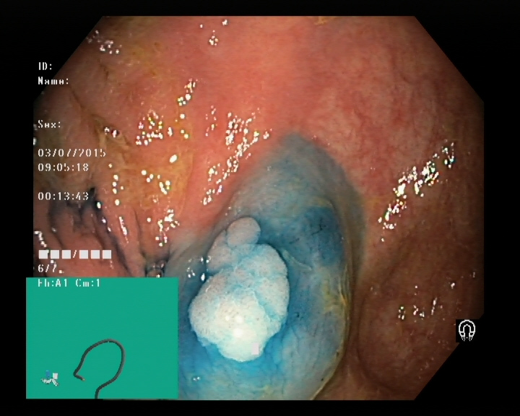
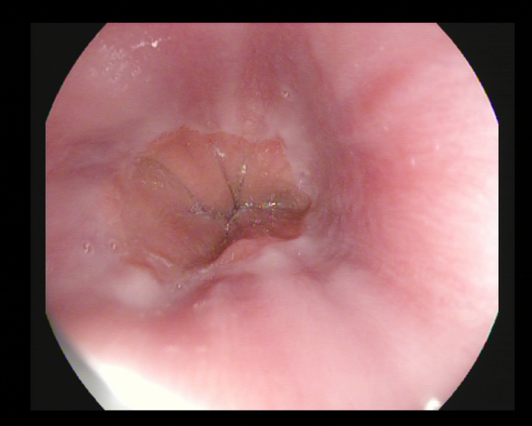
MODULES – DATA PREPROCESSING AND DATA AUGMENTATION
Images are processed using the ImageDataGenerator class to perform various augmentations such as rotation, shearing, zooming, and horizontal flipping.

Slide 10
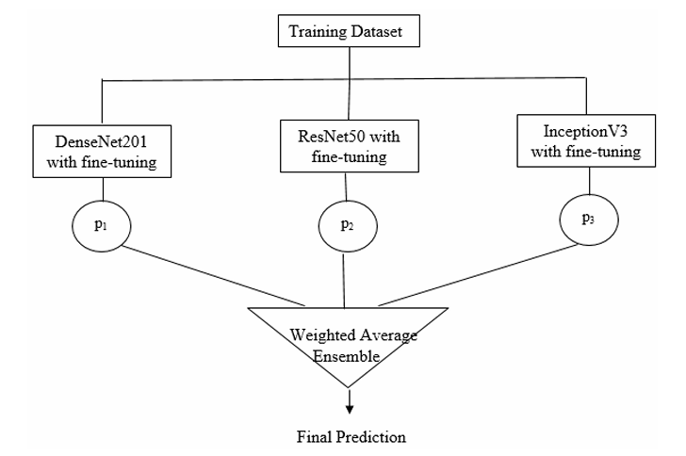
EXISTING APPROACH

Slide 11
PROPOSED METHODOLOGY
DATA COLLECTION
DATA AUGMENTATION
VGG
GOOGLENET
RESNET50
MOBILENET
BEST MODEL
COMBINED WITH GAN ARCHITECTURE

Slide 12
MODULES – TRAINING AND EVALUATION
EVALUATION METRICS
The following metrics provide insights into the model's performance in classifying colorectal tract abnormalities
Accuracy
Precision
Recall
AUC (Area Under the Curve)

Slide 13
REFERENCES
GIT-Net: An Ensemble Deep Learning-Based GI Tract Classification of Endoscopic Images by Hemalatha Gunasekaran 1ORCID,Krishnamoorthi Ramalakshmi
Transformer-based multi-task learning for classification and segmentation of gastrointestinal tract endoscopic images by Suigu Tang a , Xiaoyuan Yu
Colorectal cancer prediction via histopathology segmentation using DC-GAN and VAE-GAN R. Sujatha1, Mahalakshmi
A New Approach for Gastrointestinal Tract Findings Detection and Classification: Deep Learning-Based Hybrid Stacking Ensemble Models by Esra Sivari 1,Erkan Bostanci
A Comprehensive Analysis of Deep Learning-Based Approaches for the Prediction of Gastrointestinal Diseases Using Multi-class Endoscopy Images by Sanjeev kumar , Yogesh kumar
Efficient Gastrointestinal Disease Classification Using Pretrained Deep Convolutional Neural Network by Muhammad Nouman Noor 1,Muhammad Nazir

Slide 14
THANK YOU

